Slide 1
What are the Challenges for TinyML?
Part D

Slide 2
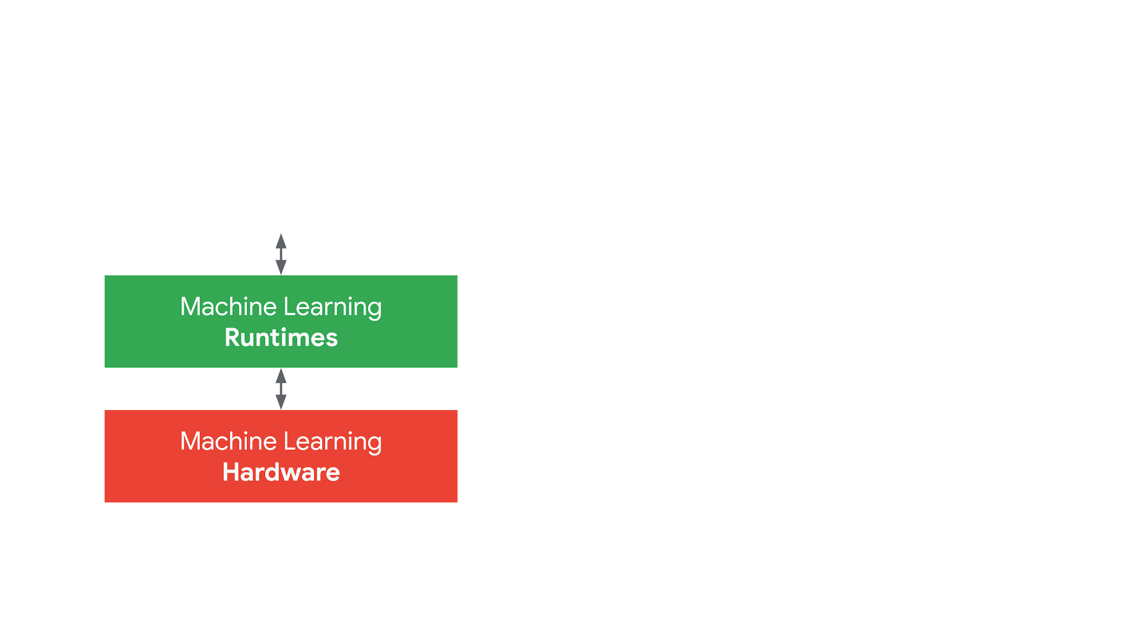
Half-screen. Show presenter.
Machine Learning Models

Slide 3
Model Compression Techniques
Half-screen. Show presenter.
Pruning
Quantization
Knowledge Distillation
...
Notes:
Good resource: https://nervanasystems.github.io/distiller/index.html

Slide 4
Model Compression Techniques
Half-screen. Show presenter.
Pruning
Quantization
Knowledge Distillation
...
Notes:
Good resource: https://nervanasystems.github.io/distiller/index.html

Slide 5
Pruning

Slide 6
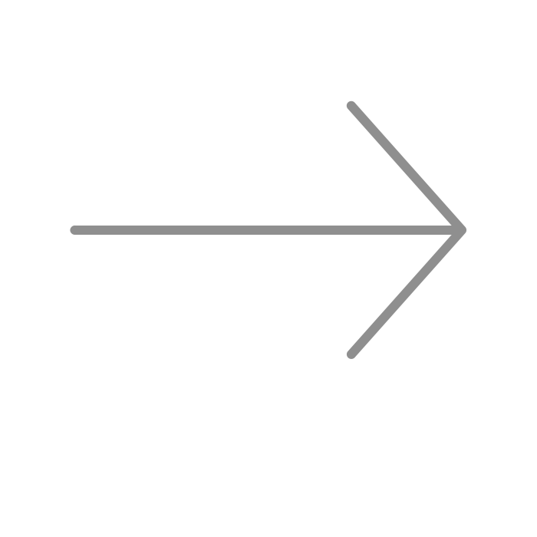
Pruning
PRUNING SYNAPSES

Slide 7
Pruning
PRUNING NEURONS

Slide 8
Model Compression Techniques
Half-screen. Show presenter.
Pruning
Quantization
Knowledge Distillation
...
Notes:
Good resource: https://nervanasystems.github.io/distiller/index.html

Slide 9
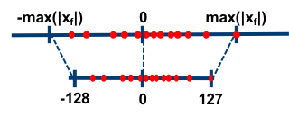
Quantization
float32
max(|x_{f}|)
0
min(|x_{f}|)

Slide 10
Quantization
float32
int8
max(|x_{f}|)
127
0
0
-128
min(|x_{f}|)

Slide 11
Quantization
float32
int8
max(|x_{f}|)
127
0
0
-128
min(|x_{f}|)

Slide 12
Model Compression Techniques
Half-screen. Show presenter.
Pruning
Quantization
Knowledge Distillation
...
Notes:
Good resource: https://nervanasystems.github.io/distiller/index.html

Slide 13


Knowledge Distillation
TEACHER
STUDENT
Notes:
Teacher: https://commons.wikimedia.org/wiki/File:Emoji_u1f468_1f3fe_200d_1f3eb.svg
Student: https://commons.wikimedia.org/wiki/File:Emoji_u1f469_1f3fc_200d_1f393.svg

Slide 14
Knowledge Distillation
TEACHER
STUDENT
Notes:
Teacher: https://commons.wikimedia.org/wiki/File:Emoji_u1f468_1f3fe_200d_1f3eb.svg
Student: https://commons.wikimedia.org/wiki/File:Emoji_u1f469_1f3fc_200d_1f393.svg

Slide 15
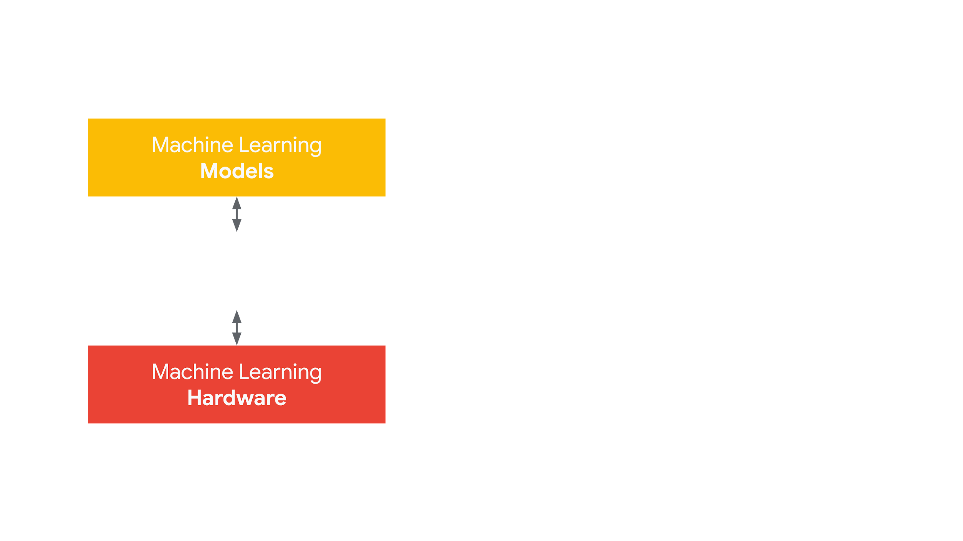
Half-screen. Show presenter.
Machine Learning
Runtimes

Slide 16
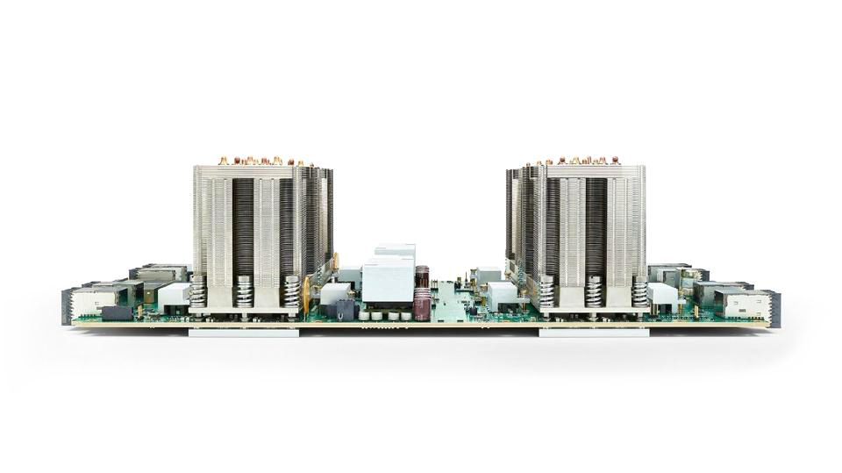

Slide 17

Notes:
https://commons.wikimedia.org/wiki/File:TensorFlow_Logo_with_text.png

Slide 18
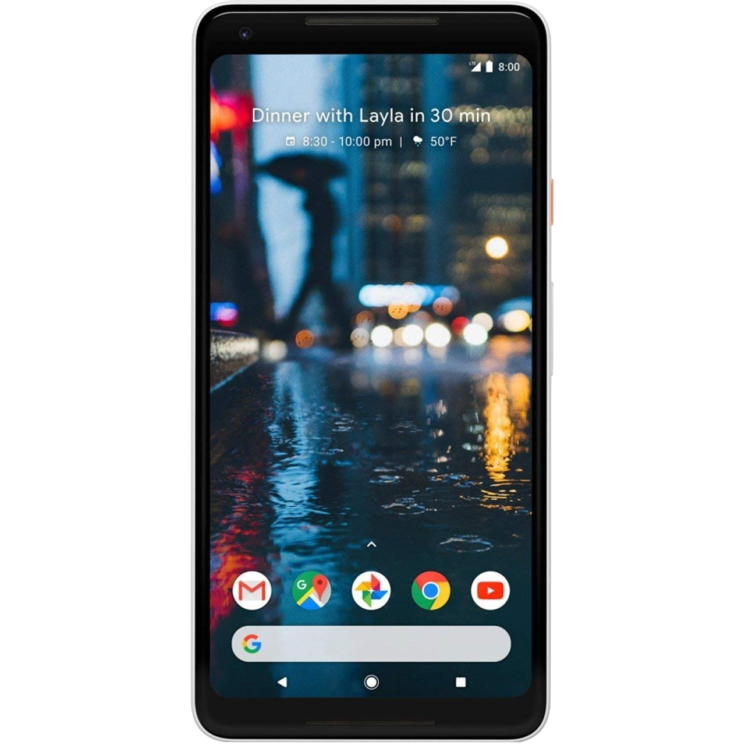
Notes:
https://search.creativecommons.org/photos/6e63331f-944b-4d61-8df3-5df190d63751

Slide 19
Less memory
Notes:
https://search.creativecommons.org/photos/6e63331f-944b-4d61-8df3-5df190d63751

Slide 20
Less memory
Less compute power
Notes:
https://search.creativecommons.org/photos/6e63331f-944b-4d61-8df3-5df190d63751

Slide 21
Less memory
Less compute power
Only focused on inference
Notes:
https://search.creativecommons.org/photos/6e63331f-944b-4d61-8df3-5df190d63751

Slide 22

Less memory
Less compute power
Only focused on inference
Notes:
https://search.creativecommons.org/photos/6e63331f-944b-4d61-8df3-5df190d63751

Slide 24
Key Differences
Topology
Variable
Fixed
Weights
Variable
Fixed
Binary Size
Unimportant
High Priority
Distributed Compute
Not
Needed
Needed
Developer Background
ML
Researcher
Application
Developer

Slide 25
Key Differences
Topology
Variable
Fixed
Weights
Variable
Fixed
Binary Size
Unimportant
High Priority
Distributed Compute
Not
Needed
Needed
Developer Background
ML
Researcher
Application
Developer

Slide 26
Key Differences
Topology
Variable
Fixed
Weights
Variable
Fixed
Binary Size
Unimportant
High Priority
Distributed Compute
Not
Needed
Needed
Developer Background
ML
Researcher
Application
Developer

Slide 27
Key Differences
Topology
Variable
Fixed
Weights
Variable
Fixed
Binary Size
Unimportant
High Priority
Distributed Compute
Not
Needed
Needed
Developer Background
ML
Researcher
Application
Developer

Slide 28
Key Differences
Topology
Variable
Fixed
Weights
Variable
Fixed
Binary Size
Unimportant
High Priority
Distributed Compute
Not
Needed
Needed
Developer Background
ML
Researcher
Application
Developer

Slide 29
Architecture
Trained
TensorFlow Model

Slide 30
Architecture
Trained
TensorFlow Model
TensorFlow Lite Converter

Slide 31
Architecture
Trained
TensorFlow Model
TensorFlow Lite Converter
TensorFlow Lite Model File (.tflite)

Slide 32


Architecture
Trained
TensorFlow Model
TensorFlow Lite Converter
TensorFlow Lite Model File (.tflite)

Slide 33
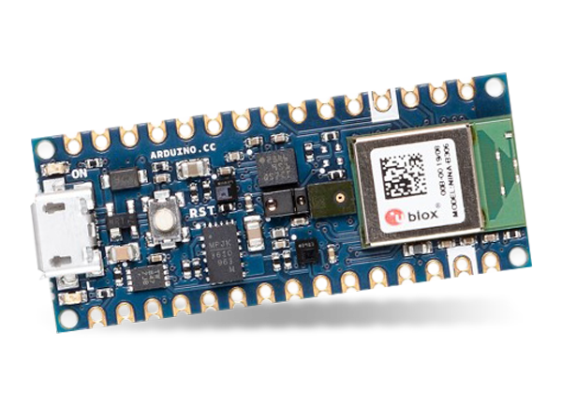
?

Slide 34
Even less memory

Slide 35
Even less memory
Even less compute power

Slide 36
Even less memory
Even less compute power
Also, only focused on inference

Slide 37
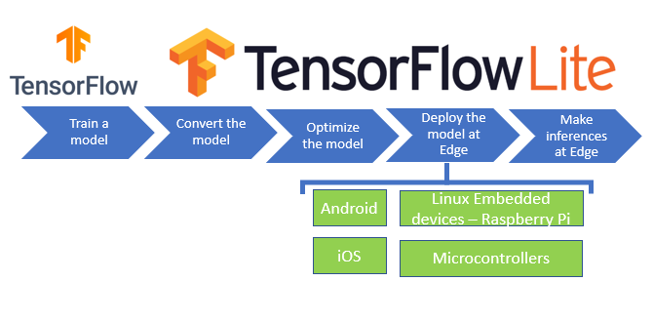

Slide 38
Train a model
Convert model
Optimize model
Deploy model at Edge
Make inferences at Edge

Slide 39
Train a model
Convert model
Optimize model
Deploy model at Edge
Make inferences at Edge

Slide 40
Train a model
Convert model
Optimize model
Deploy model at Edge
Make inferences at Edge

Slide 41
Train a model
Convert model
Optimize model
Deploy model at Edge
Make inferences at Edge

Slide 42


Train a model
Convert model
Optimize model
Deploy model at Edge
Make inferences at Edge
Linux
Notes:
https://thenounproject.com/search/?q=microcontroller&i=3151803

Slide 43
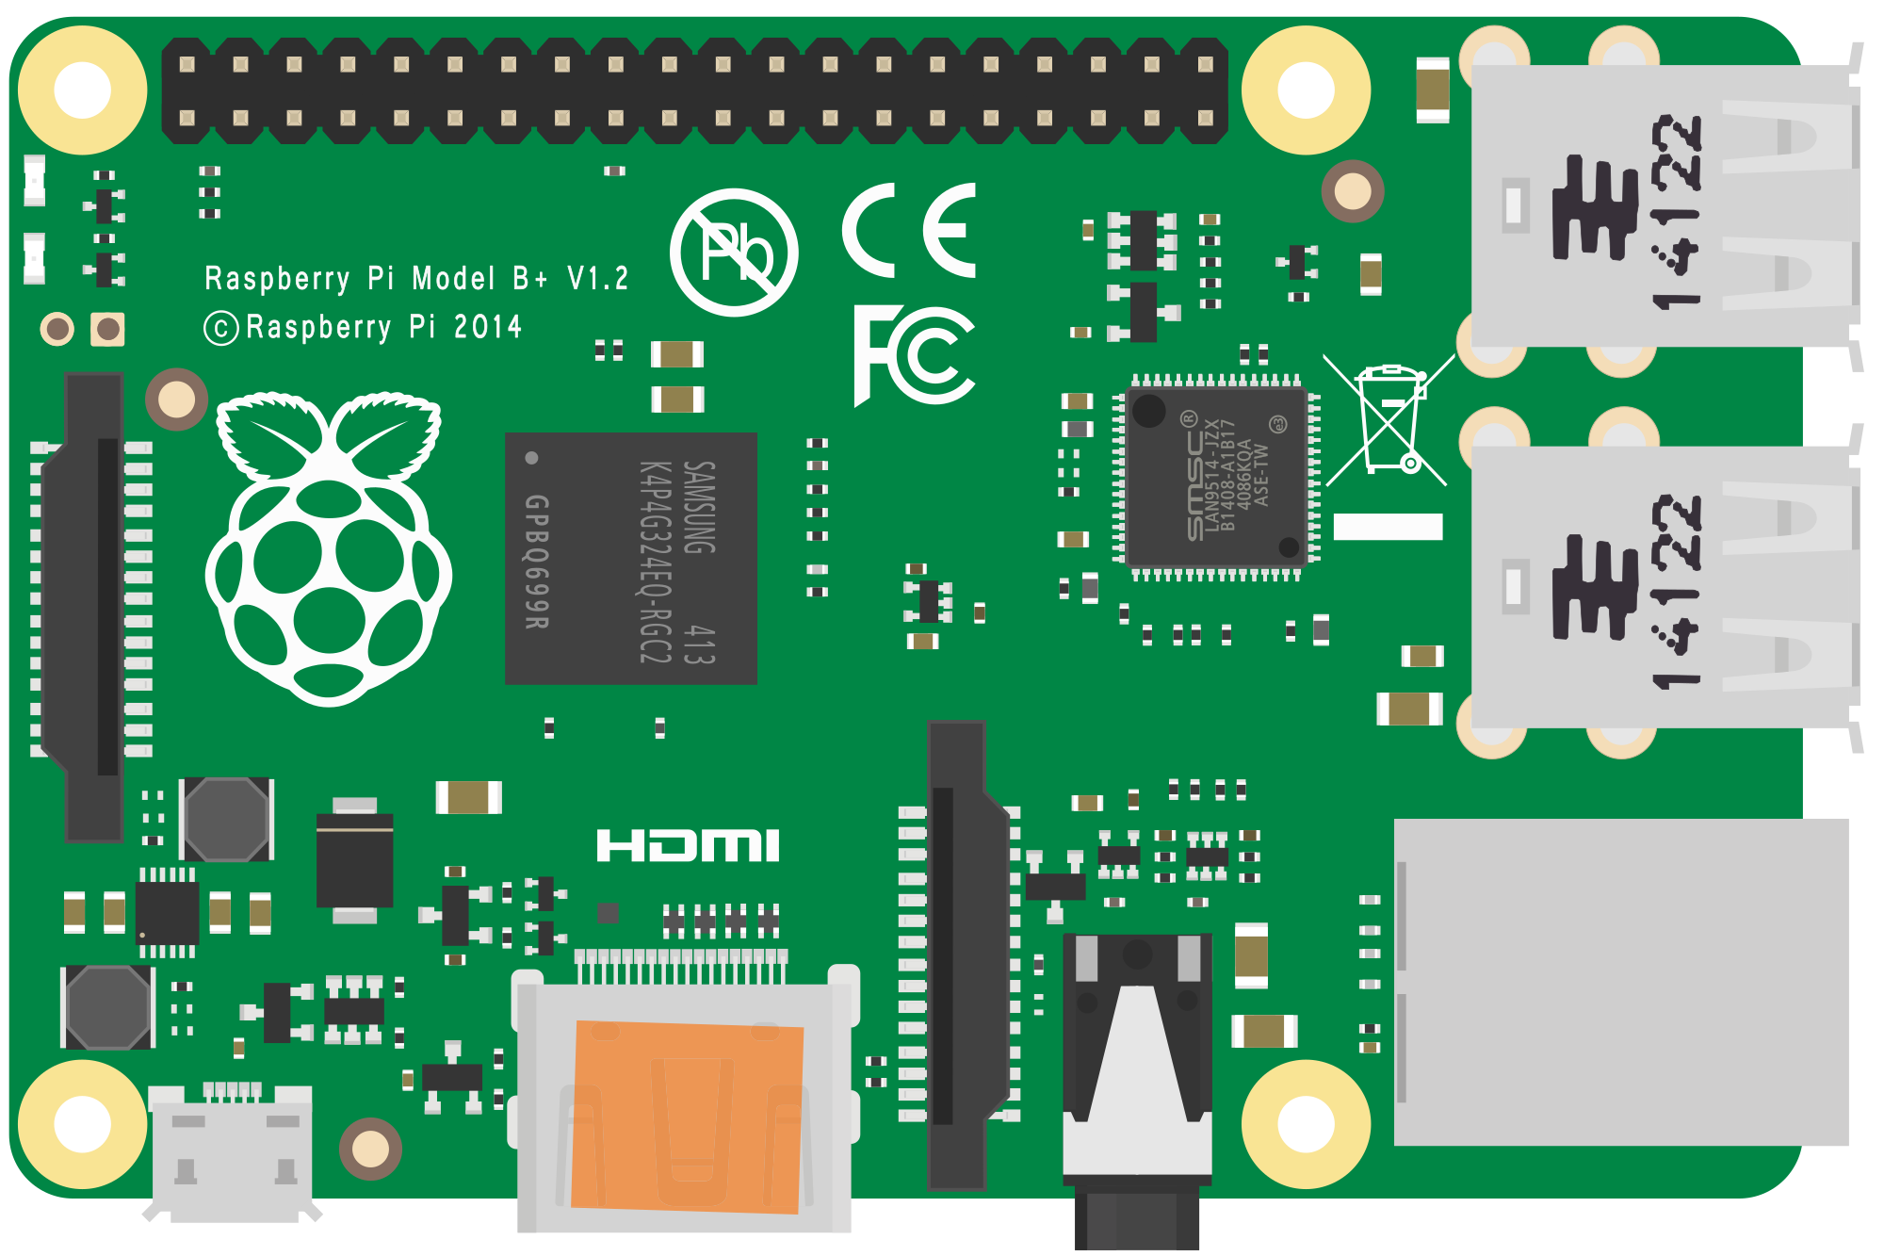
Train a model
Convert model
Optimize model
Deploy model at Edge
Make inferences at Edge
Linux
Raspberry Pi
Notes:
https://thenounproject.com/search/?q=microcontroller&i=3151803
https://commons.wikimedia.org/wiki/File:Raspberry_Pi_B%2B_illustration.svg

Slide 44
Train a model
Convert model
Optimize model
Deploy model at Edge
Make inferences at Edge
Linux
Microcontroller
Notes:
https://thenounproject.com/search/?q=microcontroller&i=3151803
https://commons.wikimedia.org/wiki/File:Raspberry_Pi_B%2B_illustration.svg

Slide 45
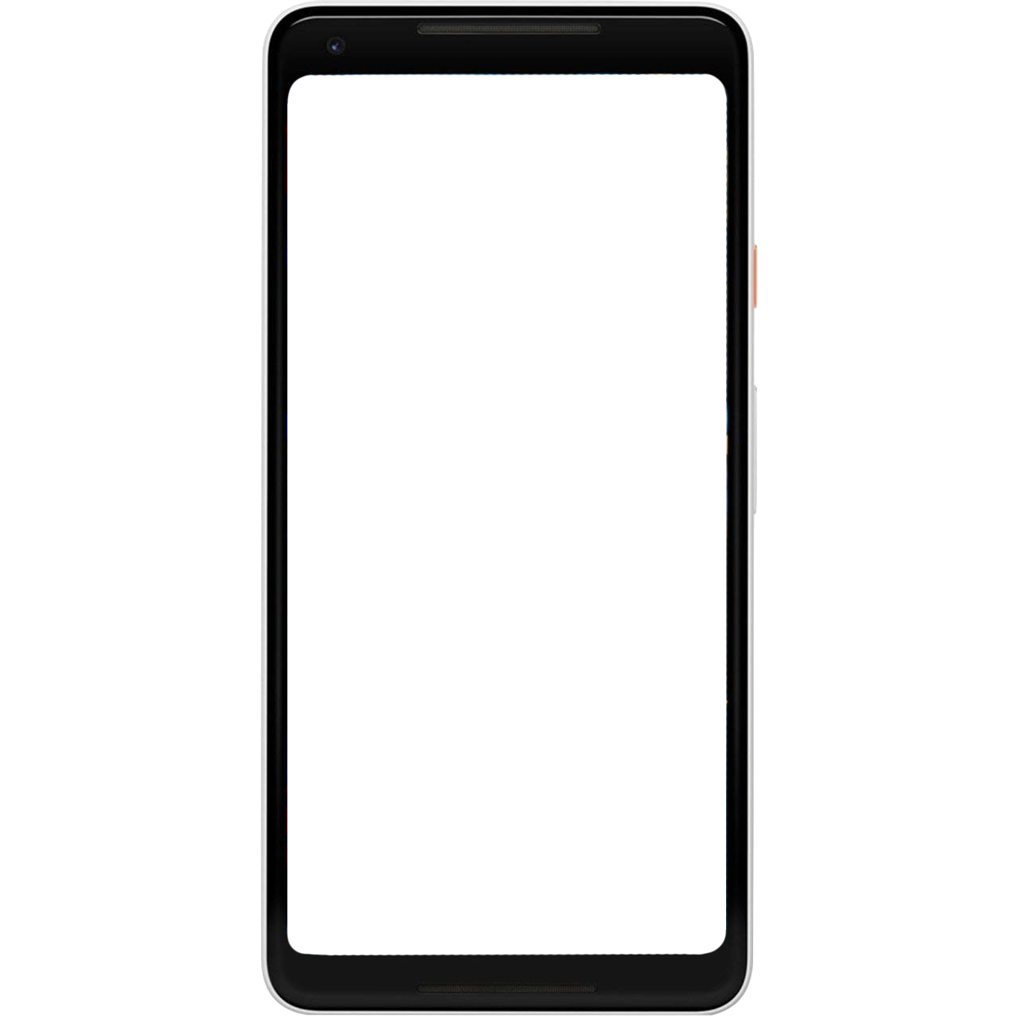
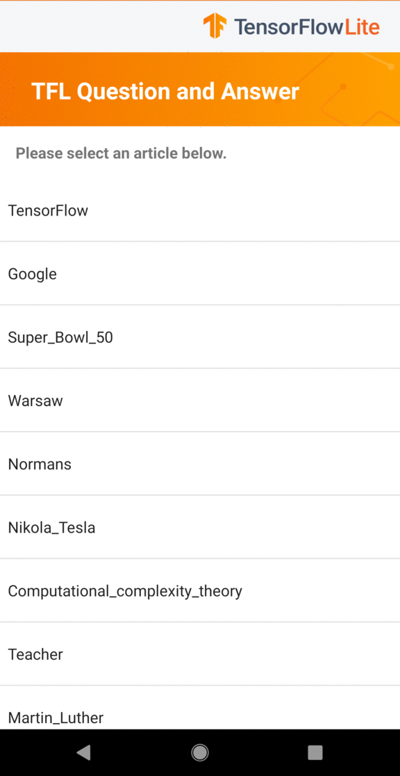
Train a model
Convert model
Optimize model
Deploy model at Edge
Make inferences at Edge

Slide 46
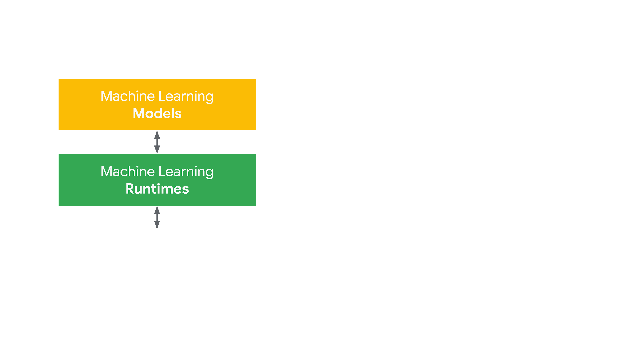
Half-screen. Show presenter.
Machine Learning Hardware

Slide 47
Fullscreen. Show presenter.

